Slide 1
Lab work 1: data basics
Please download the exome data of Jiankui He
Write your own program using perl, python, R, or any programing language
Calculate the Q score, GC content

Slide 2
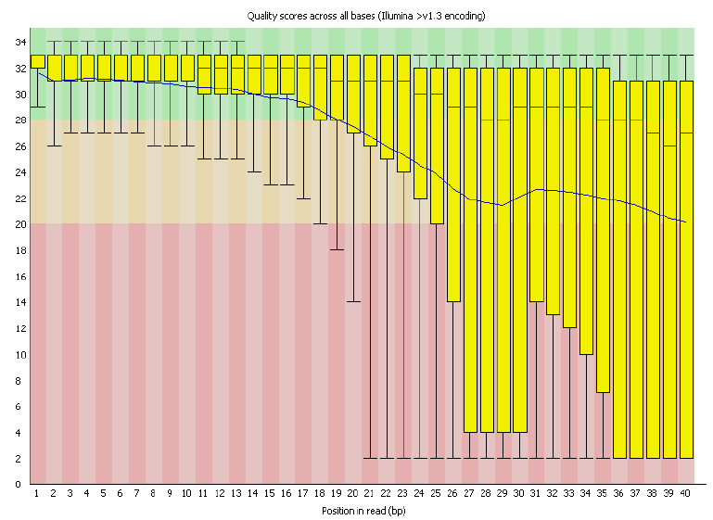
Quality score across all bases

Slide 3
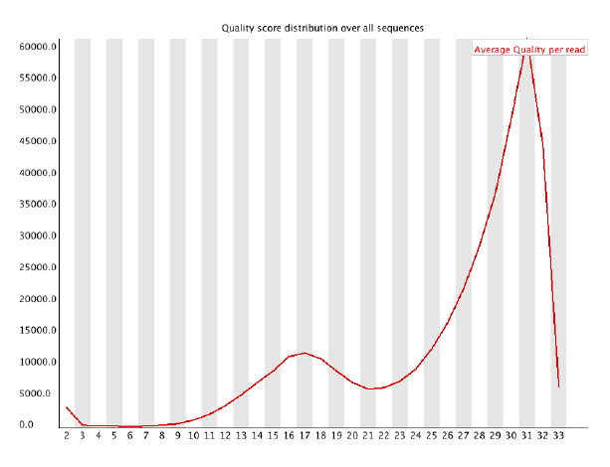
Quality score distribution over all sequences

Slide 4
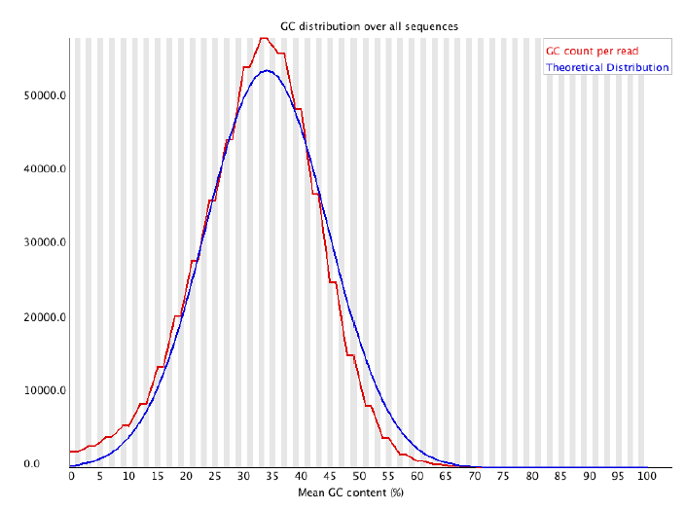
GC distribution over all sequences

